Slide 1


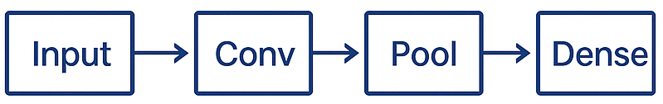
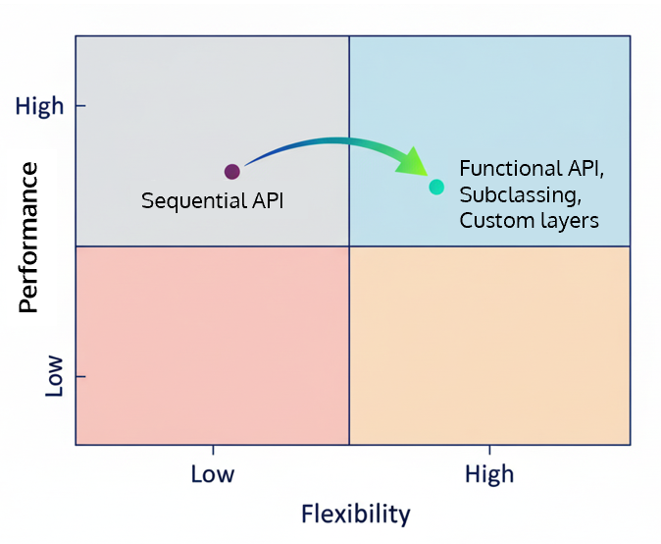
Constricting Neural Networks
Sequential, Functional, Subclassing & Custom Layers
Sequential API
Advanced Model-building APIs
Functional API
Model Subclassing
Custom Layers
Much complex models possible
More flexibility without compromising performance
Simple
Straight-line model
Limited Customization

Slide 2
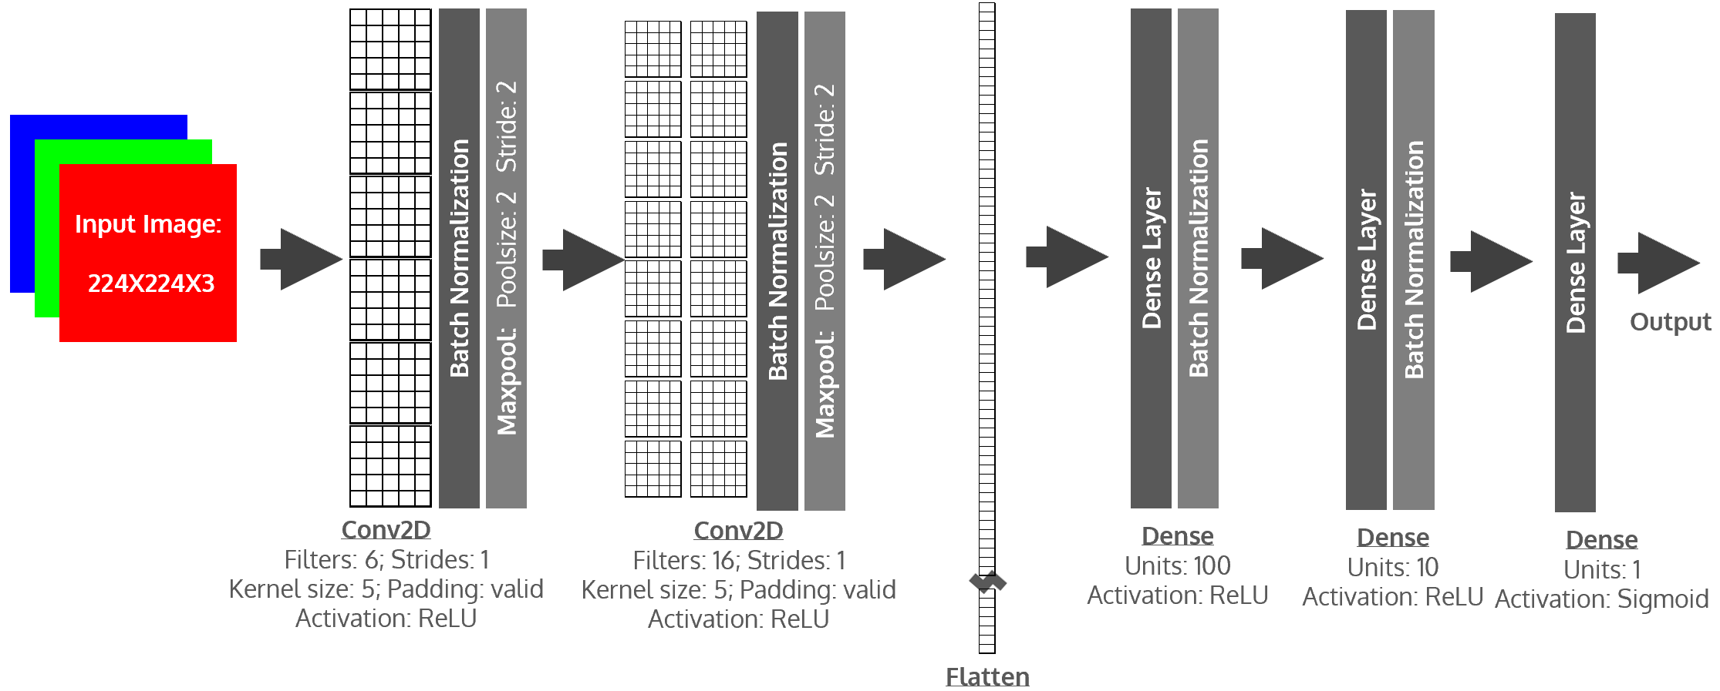
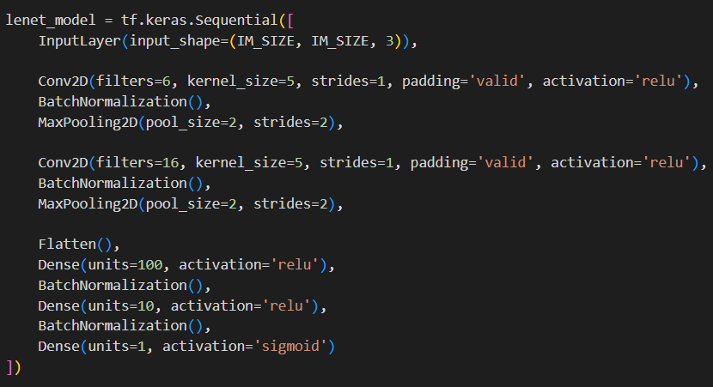
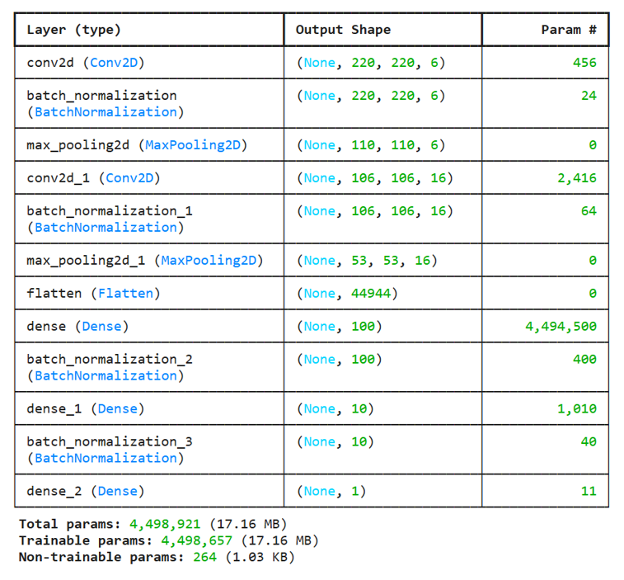
Sequential Model Creation

Slide 3
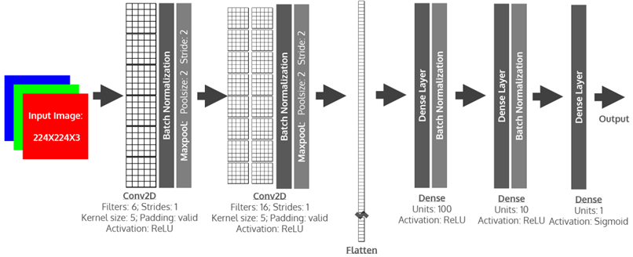
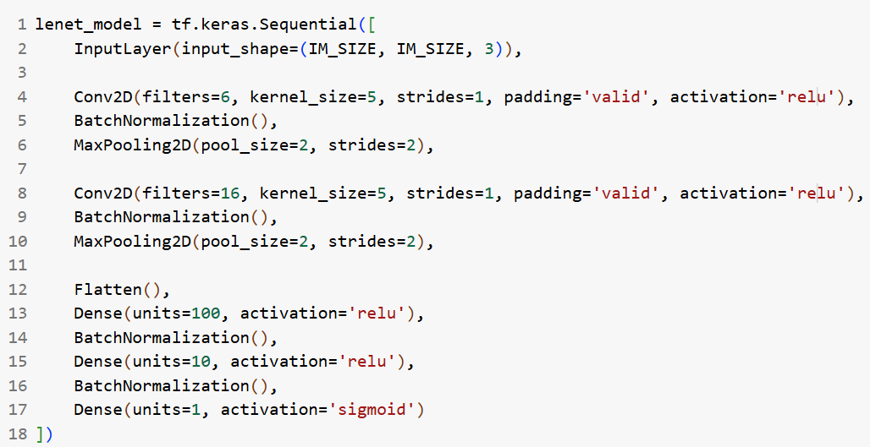
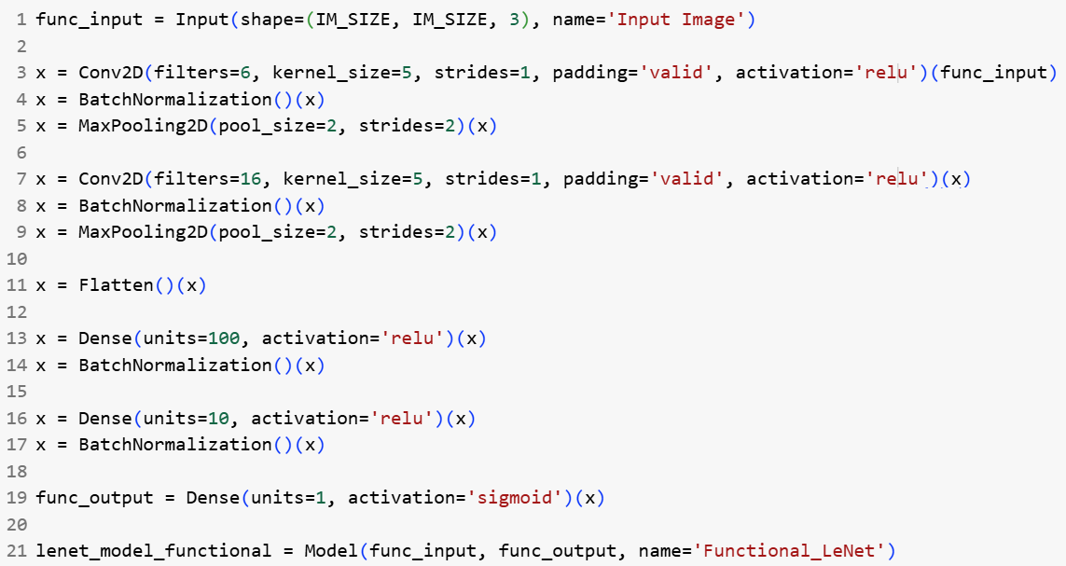
Functional Model Creation
Each layer is created by a function call
Previous layers are passed in as the function’s parameters

Slide 4
Two Flexible Approaches
Functional API
Model Subclassing
Input
tf.keras.Model
Layer
Layer
def __init__():
…
def call():
…
Output

Slide 5
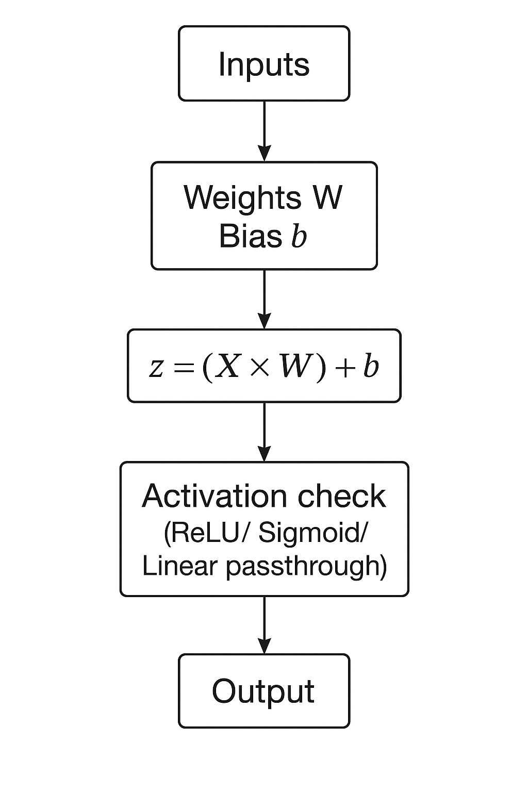
Going Past the Standard Layers
Why Custom Layers?
Logic for desired activation in layers
Full control over weights and biases
Reusable blocks

